Slide 1
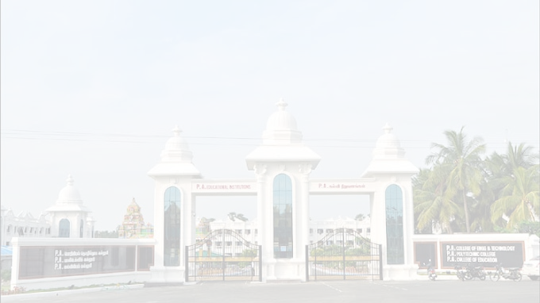

P.A
COLLEGE OF ENGINEERING AND TECNOLOGY
An Autonomous Institution
Approved by AICET and Affiliated to Anna University
Accredited by NBA(CSE,ECE,EEE&MECH) and NAAC with 'A' Grade
INTERFACING IOT AND ML
PPT Presented by
A.Karankumar
V.gokul

Slide 2
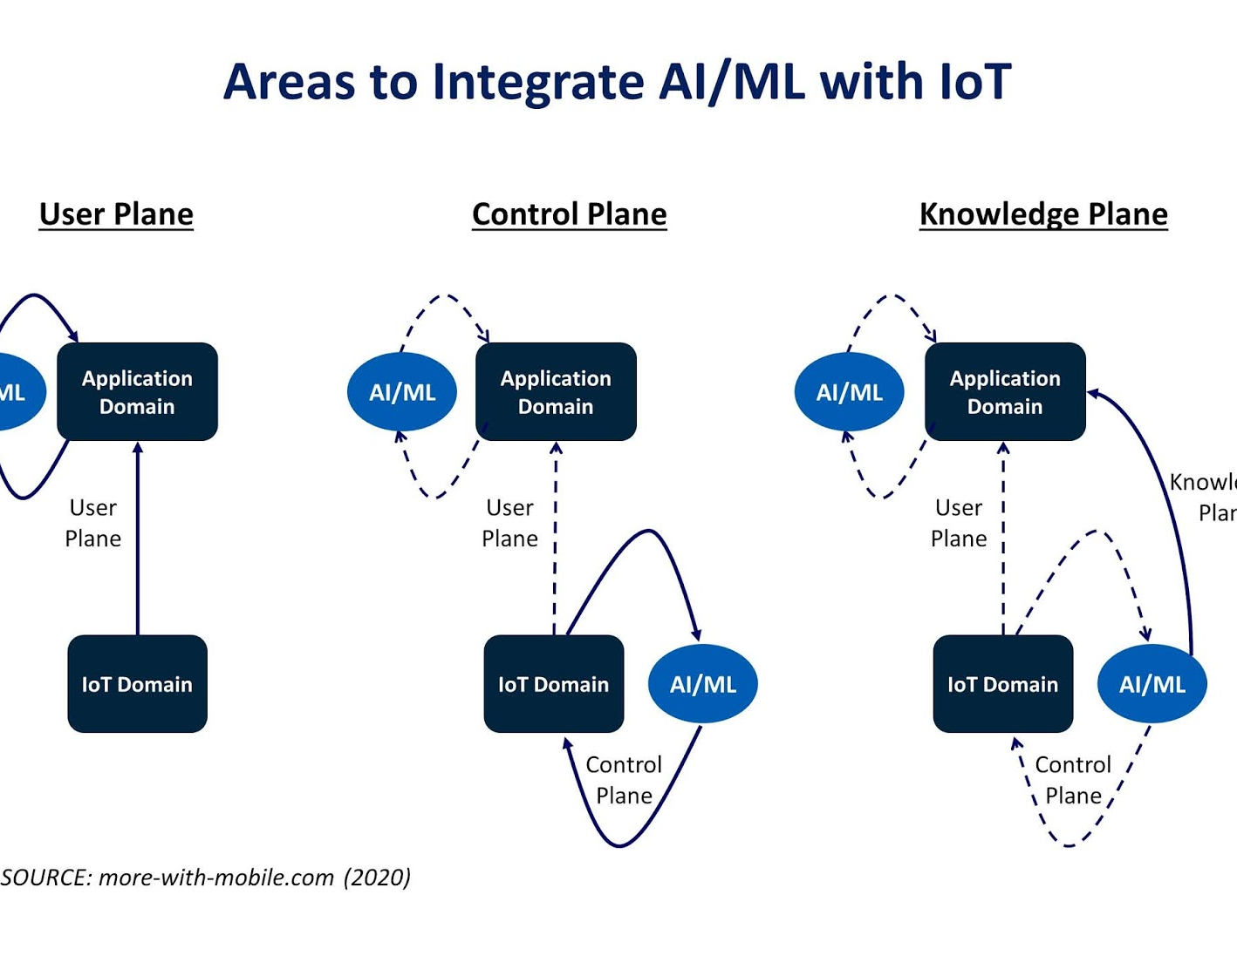
Introduction
The Internet of Things generates massive volumes of data from millions of devices. Machine learning is powered by data and generates insight from it. Machine learning uses past behavior to identify patterns and builds models that help predict future behavior and events.

Slide 3
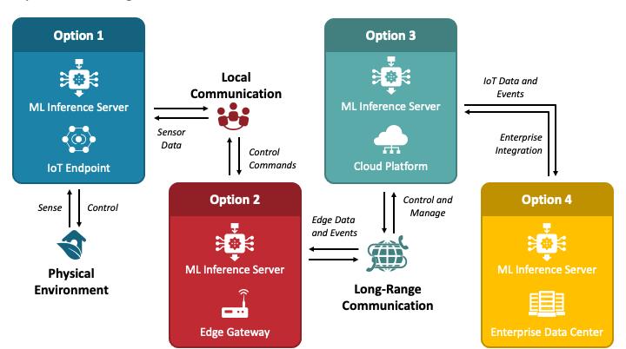
MACHINE LEARNING WITH IOT

Slide 4
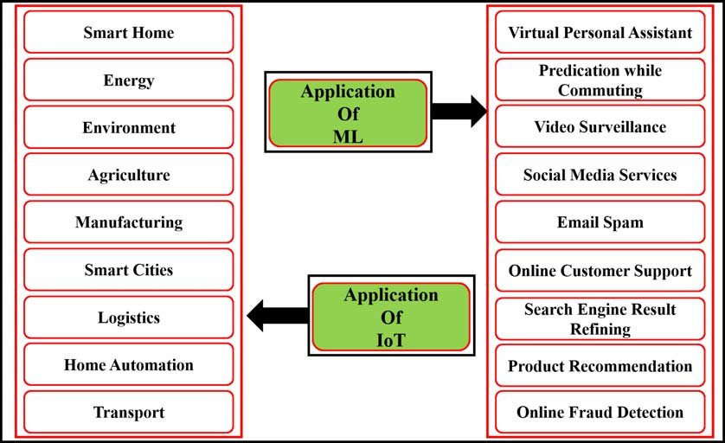
Applications

Slide 5
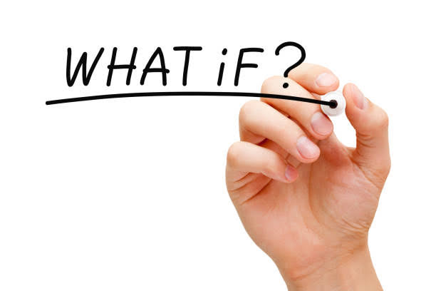
Sensor Assisted Smart White Cane Implementation for VISUALLY IMPAIRED using INTERFACING ML what is third eye for visually impaired…...

Slide 6
Third eye for visually impaired!
People who suffer from a severe reduction in vision that cannot be corrected with the help of medical field ……
What is a next step……. For visually impaired ….
some of the young generation as we are planed a project it is know as third eye for visually impaired.

Slide 7
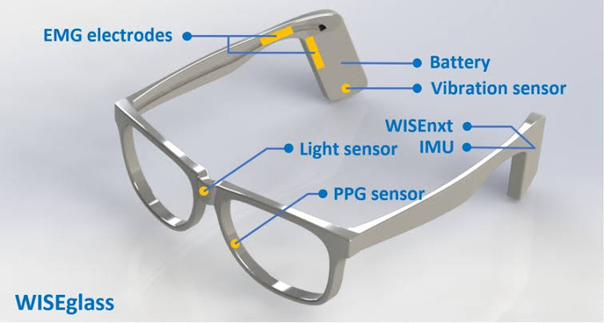
Abstract
According to who, 30 million people are permanently blind and 285 billion people with vision impairment. If you notice then they face many obstacle in their way ,or they can’t walk without the help of other. One has to ask guidance to reach their destination. They have to face more struggles in their daily life .Using this smart stick , a people who suffer, they can reach their destination without help of other.

Slide 8
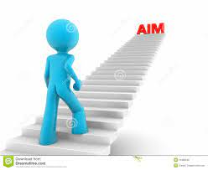
Aim
The main objective of this is to provide an application for blind people to defect the obstacles in various directions, detecting pits and manholes on the ground to make free to walk , in an innovative stick is designed for the visually disabled people for their easy navigation.

Slide 9
INTRODUCTION Smart Stick for Blind using Machine Learning
The quantity of visually impaired folks area unit expected to grow within the future because of numerous reasons. As a result, there's a necessity for a value effective system which will be employed by blind folks so as to steer simply and well. it's necessary that a sensible resolution is planned for the blind folks in order that they will use this in their way of life.So we introduce the smart stick using machine learning

Slide 10
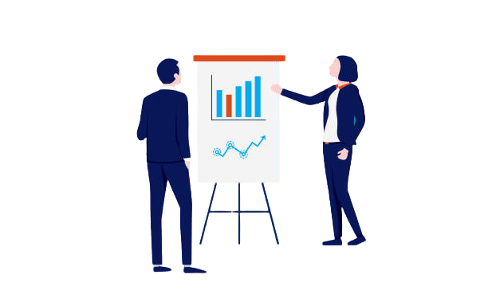
PROPOSED WORK
A. Existing System
B. Methodology
C. Obstacle Detection
D. Navigation
E. Emergency alert
F. Communication System

Slide 11
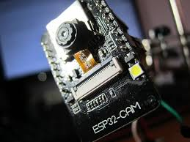
Methodology
The stick is embedded with Raspberry Pi, GSM module, GPS module, vibrator,ESP camera, switches and sensors. If any device is invoked, the vibrator that is placed over the handle vibrates. If the visually impaired person needs to grasp their current location they'll press the switch allotted for that purpose, associate degree audio relating to this location is detected by the blind man with the assistance of Bluetooth audio device.

Slide 12
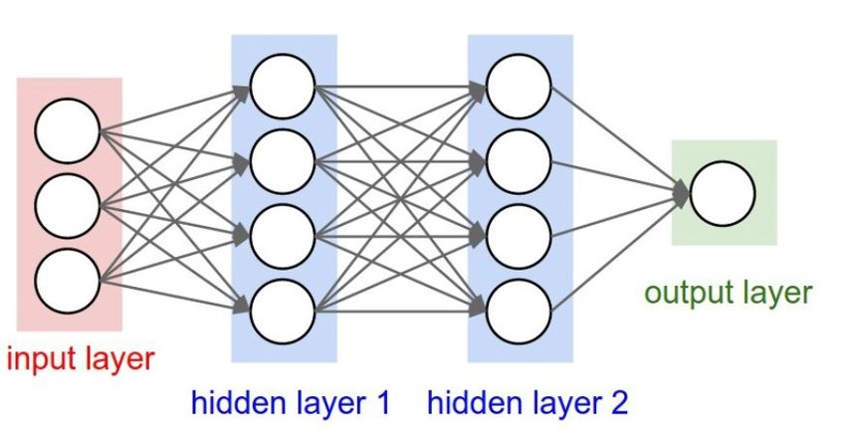
Coding First, we analyzed the nation and collection diagrams and then we wrote a pseudo code for each module. Then we used Renesas dice Suite software to application the pseudo code in embedded c program languageperiod. any other a part of the coding required us to increase an android app which interfaced with the Bluetooth module. We wrote the code thus while both of the switches had been pressed. set of rules Used for object identification the usage of system mastering: Convolution Neural Networks.

Slide 13
REQUIREMENT SPECIFICATION
A. Hardware Requirements
Raspberry Pi 3 B module.
Ultrasonic sensors.
IR sensor
Vibrator
Bluetooth module.
Push Buttons
Stick body(plastic)
ESP camera
B. Software Requirements
Raspberry pi programming with Python
Google Assistant SDK.

Slide 14
EXPERIMENTAL RESULTS
Developed a model that may verify barriers and conjointly give knowledge on a navigation system based mostly inaudible device for barrier detection .Developed a model for visually impaired to maneuver before alright ,as well as safely navigate. created it obtainable at less expensive costs while not compromising with the functionalities. decreased its m
created a wise blind stick that is innovative high-tech stick that may facilitate visually impaired individuals to discover obstacles close to them and navigate their manner. aintenance and expense

Slide 15
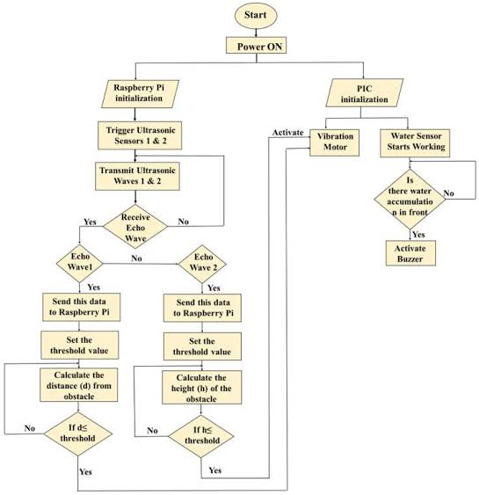
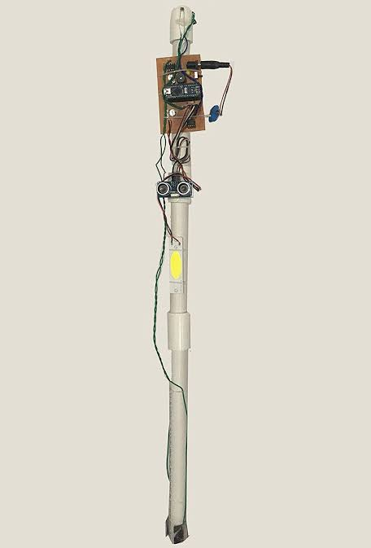
It is a first step of our project…

Slide 16
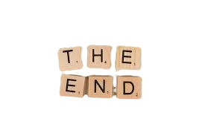
CONCLUSION
It is necessary that visually impaired folks get access to an economical and comfortable object so as to measure their way of life well . The project analyzed the present electronic aids for blind folks and supported the constraints in existing aids, this project proposes an enhanced helping electronic aid exploitation latest technology like supersonic waves, GPS, GSM .Hence our project aims to form lives higher for the visually impaired human kind Future Enhancements

Slide 17


